Slide 1


CyberSentry: Real Time Phishing Threat Identification
Capstone Project – CYB691
Team Members:
Mohammed Fouzan Aamiri
Gokul Sathiyamurthy
Jagdeep Kainth
Yveto Meus

Slide 2

Problem Statment
Phishing attacks are growing more sophisticated.
Traditional filters fail against modern threats using psychological manipulation + technical tricks.
Urgent Need:
Real-time detection
Scalable infrastructure
Privacy-respecting deployment
Attackers evolve. Our defense must be smarter.

Slide 3

Project Objective
Build a hybrid ML-based phishing detection system capable of:
Accurately identifying malicious content in real time
Scaling across email, web, and browser environments
Deployments:
Chrome Extension (Gmail integration)
Web UI for pasting suspicious content
Flask API backend with integrated ML models

Slide 4

Literature Review
Gupta et al. (2021):
Random Forest excels at phishing detection — fast, lightweight, 99%+ accuracy.
Wang et al. (2019):
Deep learning (RNN + CNN) captures complex phishing patterns; LSTM is key.
Mittal, Thaçi, Pranaya (2022–2024):
Chrome extensions + multi-feature models are the future of real-time phishing defense.
“Combining ML models within browser tools creates faster and smarter cyber shields.”

Slide 5
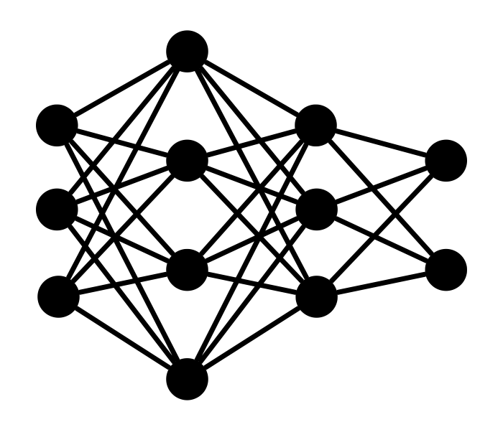
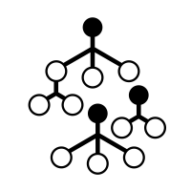
Why Random Forest & LSTM ?
Random Forest
Strengths: Fast, handles large text features (TF-IDF), robust to noisy data
Best at: Catching keywords (e.g., "urgent", "win", "account")
LSTM
Strengths: Understands sequence and context, useful for sentence structure
Best at: Detecting tone/patterns (e.g., urgency, emotional bait)
Why Both?
Random Forest finds the what, LSTM finds the how it's said
Combining them improves accuracy, reduces false positives

Slide 6
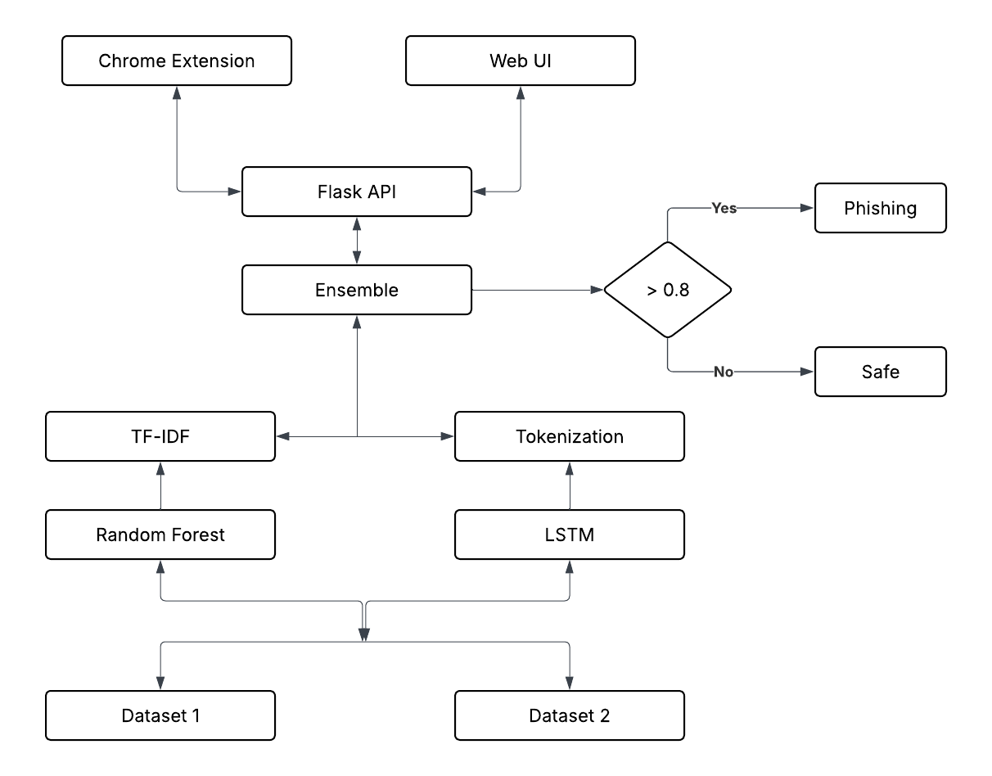
Full-System Architecture

Slide 7

Datasets used & Preprocessing
Dataset 1
Only phishing emails (1 = phishing)
Complete email bodies (subject + message)
Dataset 2
Mixed: phishing + safe (1 = phishing, 0 = safe)
Includes emails, SMS, URLs, web page snippets
Preprocessing
TF-IDF → Random Forest
Token sequences → LSTM
80/20 Train-Test Split

Slide 8
Model Training
Random Forest
100 decision trees for robust classification
TF-IDF Vectorization of 5000 important words
Effective at detecting Key phishing indicators
LSTM Neural Network
64 memory units for sequence analysis
200-word input length with padding
Trained for 5 epoch batch size 32
Ensemble Approach
Average Predictions from both models
0.8 confidence threshold for phishing classification
Combines keyword and contextual pattern detection

Slide 9
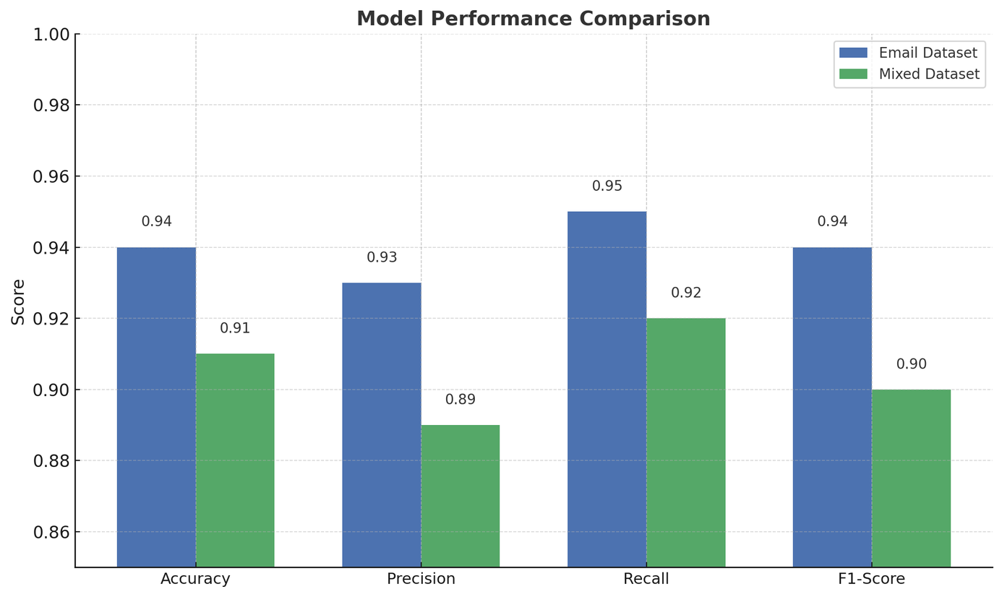
Model Evaluation & Results
Email Dataset 1 performance
Accuracy: 94%, Precision: 0.93
Recall: 0.95, F1-Score: 0.94
Mixed Email Dataset 2 performance
Accuracy: 91%, Precision: 0.89
Recall: 0.92, F1-Score: 0.90

Slide 10
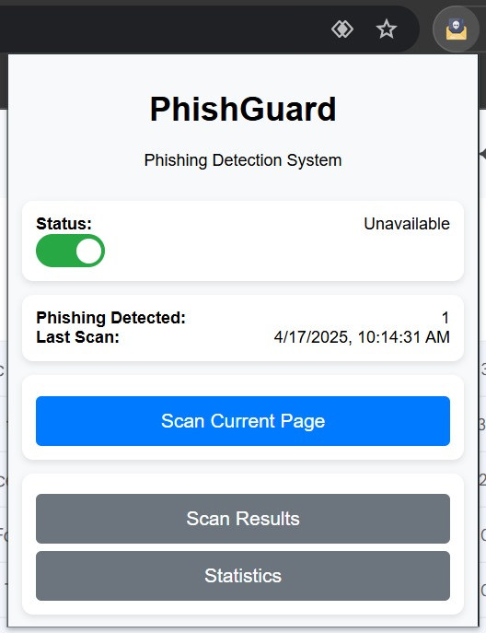
Chrome Extension (Phishguard)
Real Time
DetectionContent Script extracts email text from Gmail DOM
Secure Communications with Flask API
Average response time 1.2 seconds
Architecture
BackgroundService worker manages Communications
DOM scanner targets div[role='main'] in Gmail. JSON responses with prediction and confidence score
User Experience
In-browser warning for suspicious emails. Confidence percentage display. Safe/Phishing verdict with color coding

Slide 11
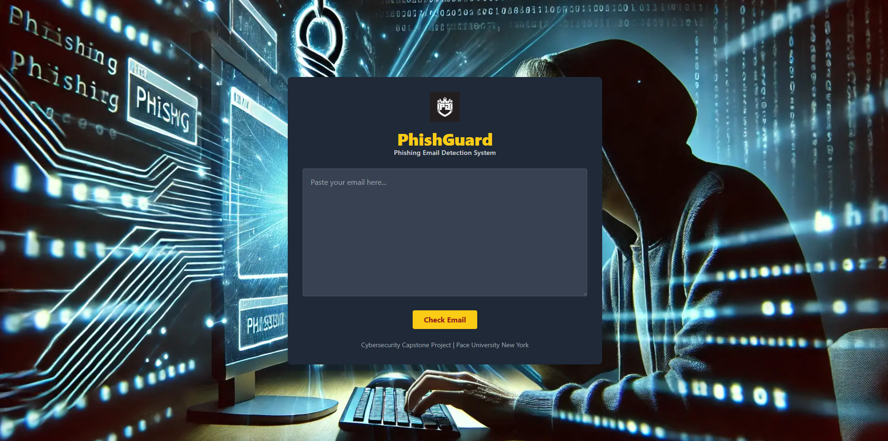
Web UI
Paste email content
Get phishing verdict + confidence %
& PDF Report download option

Slide 12
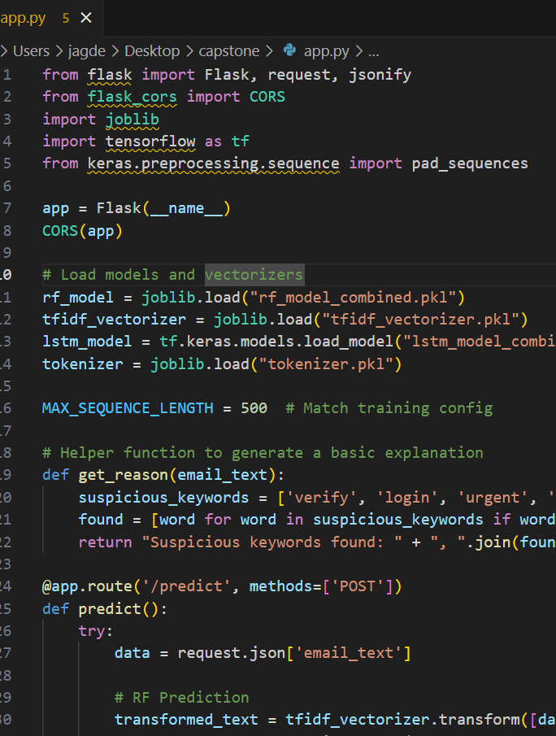
Backend Infrastructure
Flask server
Model loading (Random Forest .pkl, LSTM .h5)
Secure API (CORS enabled)

Slide 13

Conclusion
CyberSentry = High accuracy + Real-time defense
Practical browser and web app deployment
Future work: multilingual support, lighter models

